Slide 1
Consumer Insights: Investing in Securities

Slide 2
Introduction
This project explores the investment preferences and behaviors of a dataset comprising individuals across different demographics. The dataset includes information on gender, age, various investment avenues (such as mutual funds, equity market, bonds, fixed deposits), reasons for investment in specific avenues, monitoring frequency, and return expectations. The objective is to analyze patterns in investment choices and preferences among the surveyed population.

Slide 3

Project Description
The dataset consists of demographic variables like gender and age, along with categorical data detailing individuals' investment habits and preferences. Key aspects investigated include:
Investment Avenues: Analysis of preferred investment avenues such as mutual funds, equity markets, bonds, and fixed deposits.
Reasons for Investment: Exploration of motivations behind choosing specific investment avenues, such as equity, mutual funds, bonds, and fixed deposits.
Investment Duration: Distribution of investment durations chosen by investors.
Monitoring Practices: Frequency at which investors monitor their investments.
Return Expectations: Expected returns from investments, categorized by gender and other demographic factors.

Slide 4
Business Problem
Optimizing Investment Strategies Based on Insights
In today's financial landscape, understanding investor preferences and behaviors is crucial for financial institutions and advisors to tailor their offerings effectively. The dataset contains information on various aspects of investment behavior among individuals, including gender, age, preferred investment avenues, reasons for investment, monitoring practices, and return expectations.
By leveraging the data-driven insights from this analysis, financial institutions can not only optimize their investment strategies but also strengthen client relationships and achieve sustainable growth in the competitive financial services industry.

Slide 5
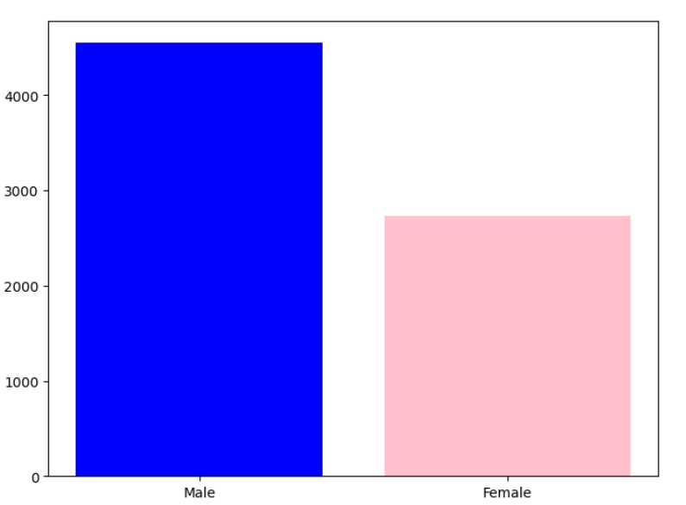
No,of. Male and Female Investors
Male count is above 4000
Female count is between 2000-3000

Slide 6
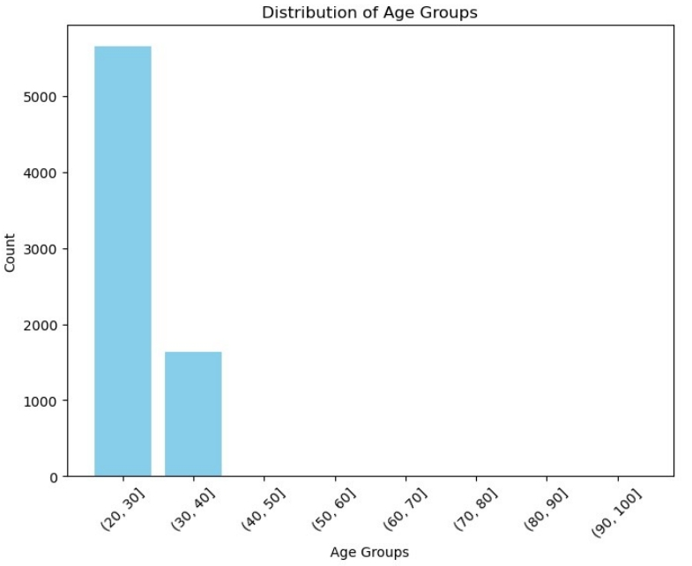
From dataset, the majority of people investing are in the 20-30 age group.
The count is above 5000 for the age group of 20-30.
The count is between 1000 - 2000 for the age group of 30-40

Slide 7
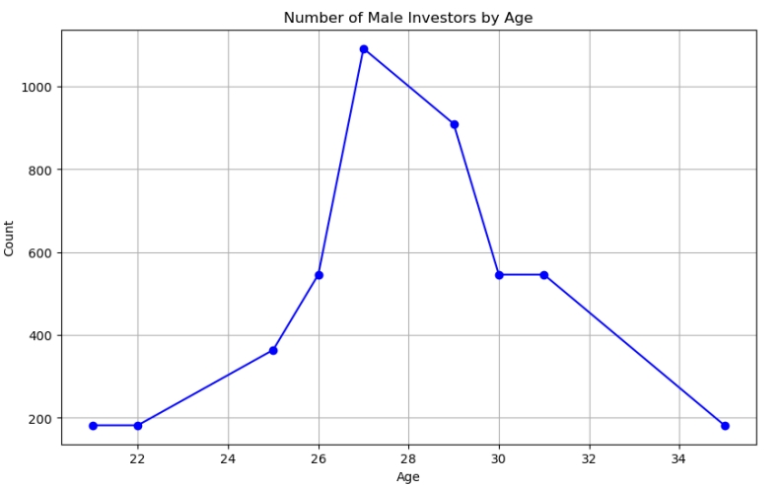
Men are more willing to invest between the ages of 26 and 30.
The Age category of 27 is investing more when compare to other age categories

Slide 8
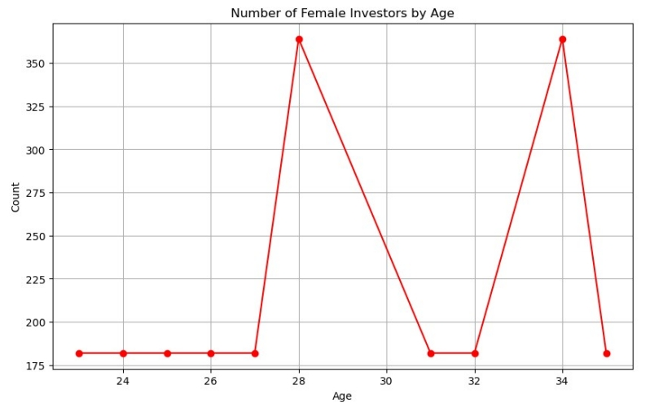
The women starts investing at the age of 23.
The Age category of 28 and 34 is investing more when compare to other age categories

Slide 9
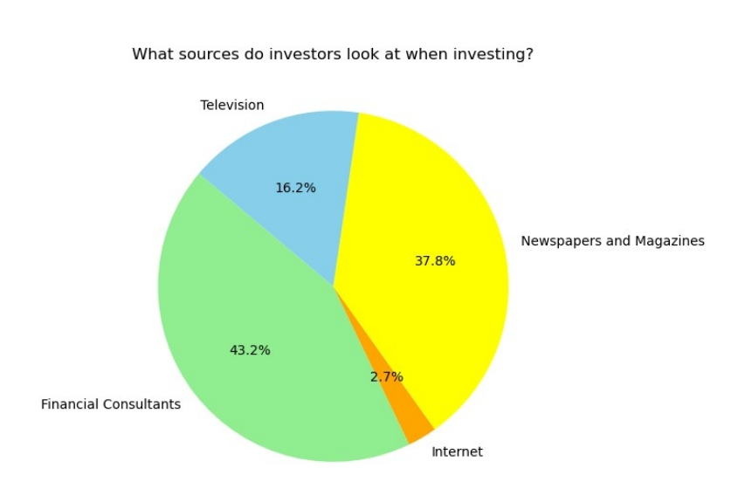
• Here we see that investors generally invest through Financial Consultants.
• Financial Consultants - 43.2%
• Television-16.2%
• Newspapers and Magazines- 37.8%
• Internet- 2.7%

Slide 10
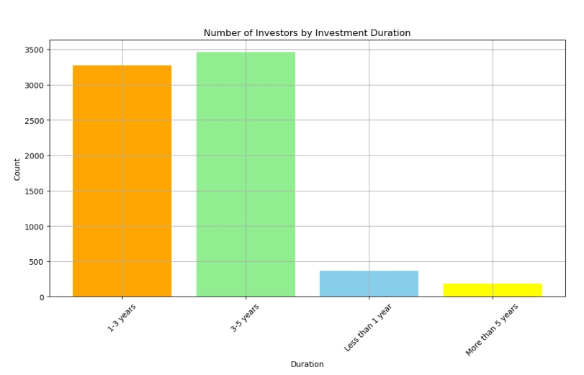
The majority of investors aim for the medium term.
1-3 years(low term) ranges above 3000
3-5 (medium term) ranges above 3300
Less than 1 year ranges below 500
more than 5 years ranges below 500

Slide 11
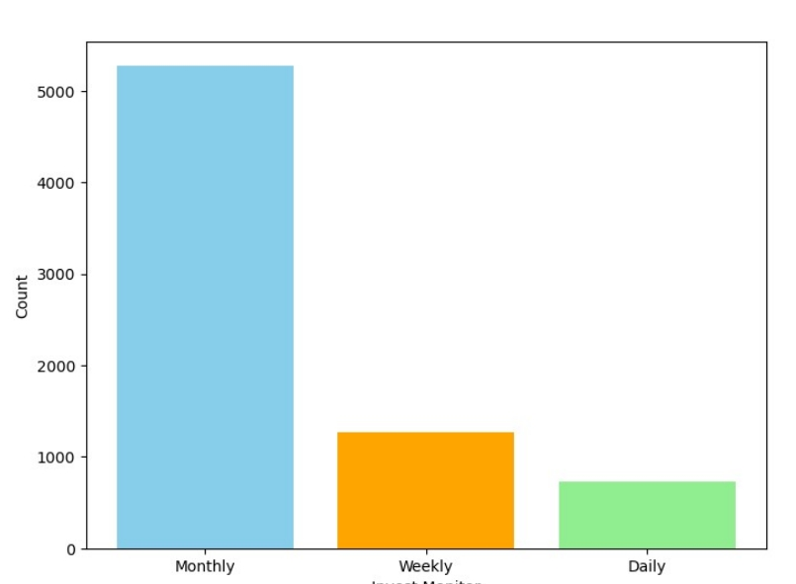
Tracking on Investments
The majority of investors prefer to track their investments on a monthly basis.
Monthly basis tracking ranges above 5000
Weekly basis tracking ranges between 1000 - 1300
Daily basis tracking ranges below 1000

Slide 12
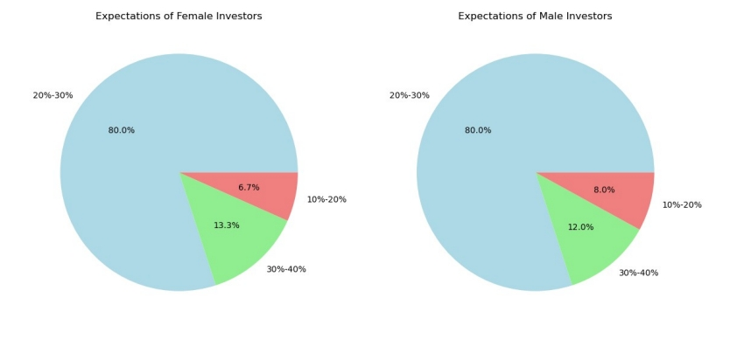
80% of men and female expect a return of 20%-30% from investments.
Female Investors(6.7 % expects 10%-20% returns), (13.3% expects 30%-40%)
Male Investors(8.0% expects 10%-20%), (12% expects 30%- 40%)

Slide 13
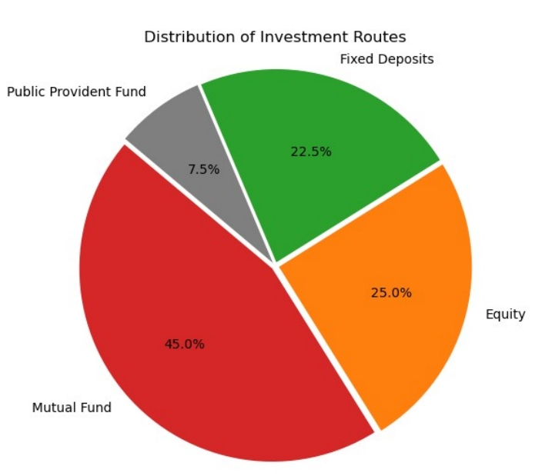
Investors prefer Mutual Funds than other
Mutual Fund - 45.0% prefers mutual fund
Equity - 25.0% prefers Equity
Fixed Deposits - 22.5% prefers Fixed deposits
PPF - 7.5% prefers Public Provident fund

Slide 14
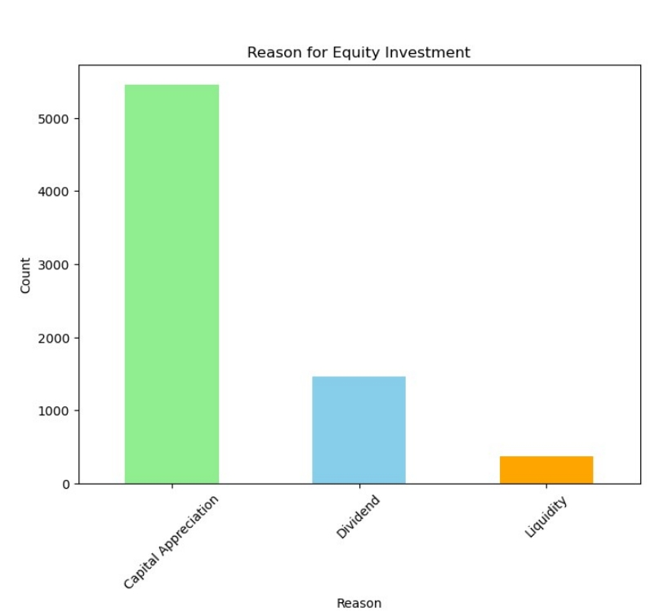
Investors who chose the stock said they were investing for Capital Appreciation.
Capital Appreciation ranges above 5000
Dividend ranges between 1000 - 2000
Liquidity ranges below 1000

Slide 15
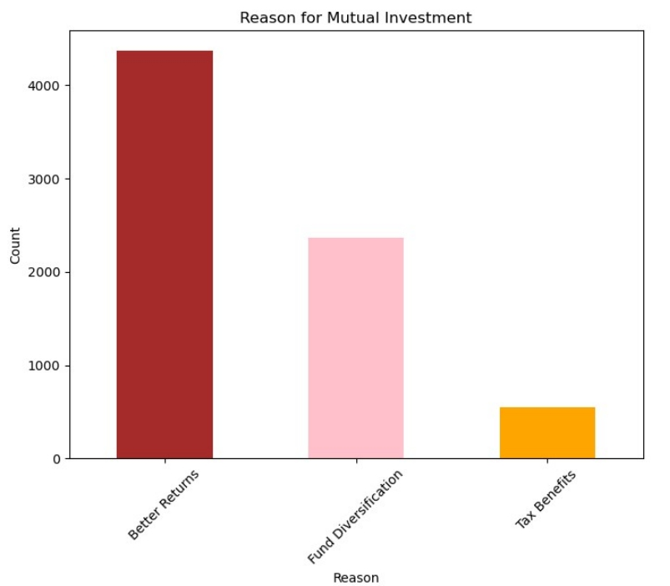
• Those who preferred Mutual Funds said that they chose it because it offered better returns.
• Better Returns ranges above 4000
• Fund Diversification ranges between 2000 – 3000
• Tax benefits ranges below 1000

Slide 16
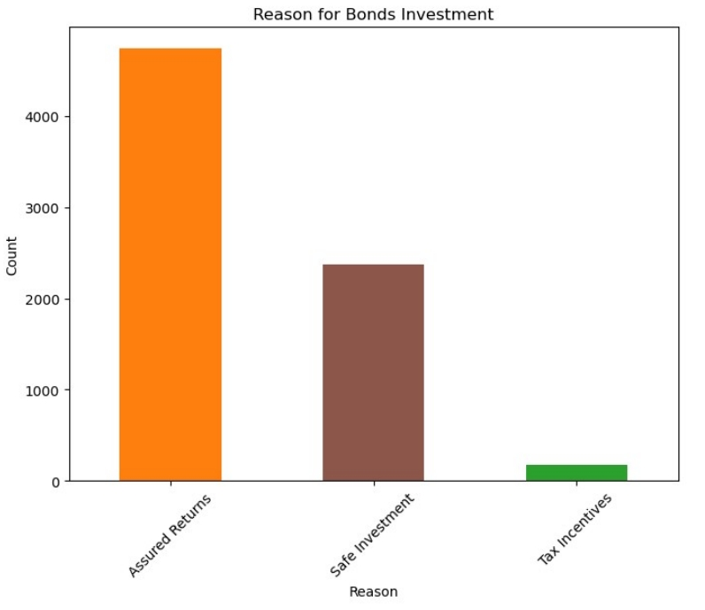
Those who preferred Mutual Funds said that they chose it because it has a Assured Return.
Assured Returns ranges above 4000
Safe investments ranges between 2000 – 3000
Tax Incentives ranges below 1000

Slide 17
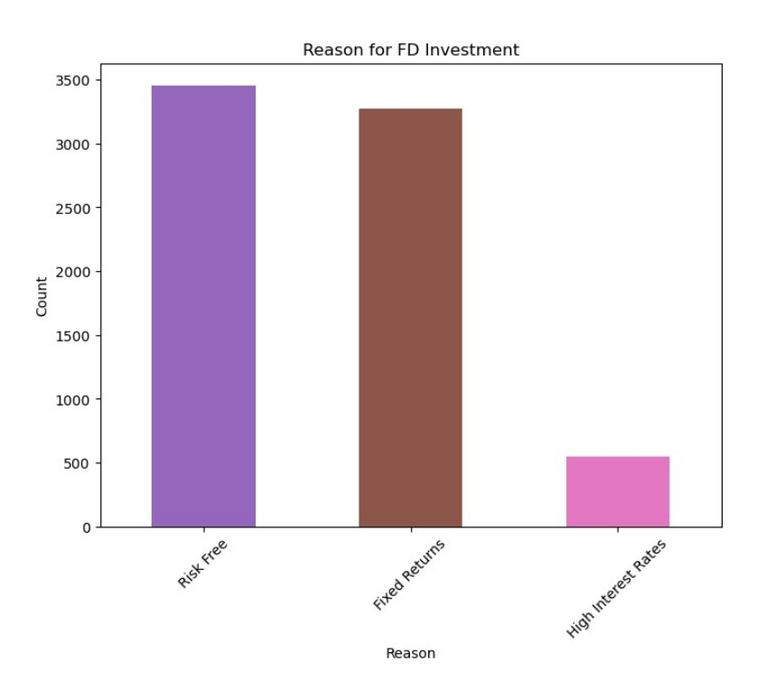
The reason for turning to this investment instrument is that it is risk-free in Term Deposits and Fixed Income.
Risk Free ranges between 3000 - 3500
Fixed Returns ranges between 3000 - 3500 but quite less than Risk Free category
High rates rated lies between 0 – 500

Slide 18
Conclusion
Through this analysis, several insights into investment behaviors among the surveyed population have been revealed:
Investment Preferences: Mutual funds and equity markets are popular investment avenues, reflecting investor interest in potential growth opportunities.
Reasons for Investment: Reasons vary widely, with factors like long-term growth potential, safety, and convenience influencing decisions across different investment options.
Demographic Differences: Gender-specific differences in investment preferences and return expectations highlight varying risk appetites and financial goals.
Age and Investment Behaviour: Analysis suggests that age may influence investment decisions, with younger investors possibly seeking higher-risk, higher-return options compared to older demographics.
Understanding these patterns can assist financial advisors and policymakers in tailoring investment products and strategies that cater to diverse investor needs and preferences. Additionally, continuous monitoring of these trends can help predict future investment behaviors and adapt financial offerings accordingly.

